Slide 1





A Roadmap to Inclusive Entrepreneurship

Slide 2



THE FUTURE OF CITIES
GO TO INITIATIVE
Action Guides
Year 1 Report

Slide 3
Agenda
Presenting the research
Panel discussion
Audience Q&A

Slide 4
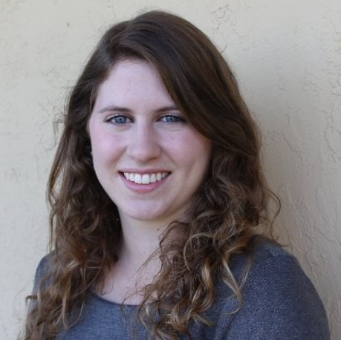
THE FUTURE OF CITIES:
A Roadmap to Inclusive Entrepreneurship
Lena Geraghty
PROGRAM DIRECTOR OF URBAN INNOVATION CENTER FOR CITY SOLUTIONS

Slide 5
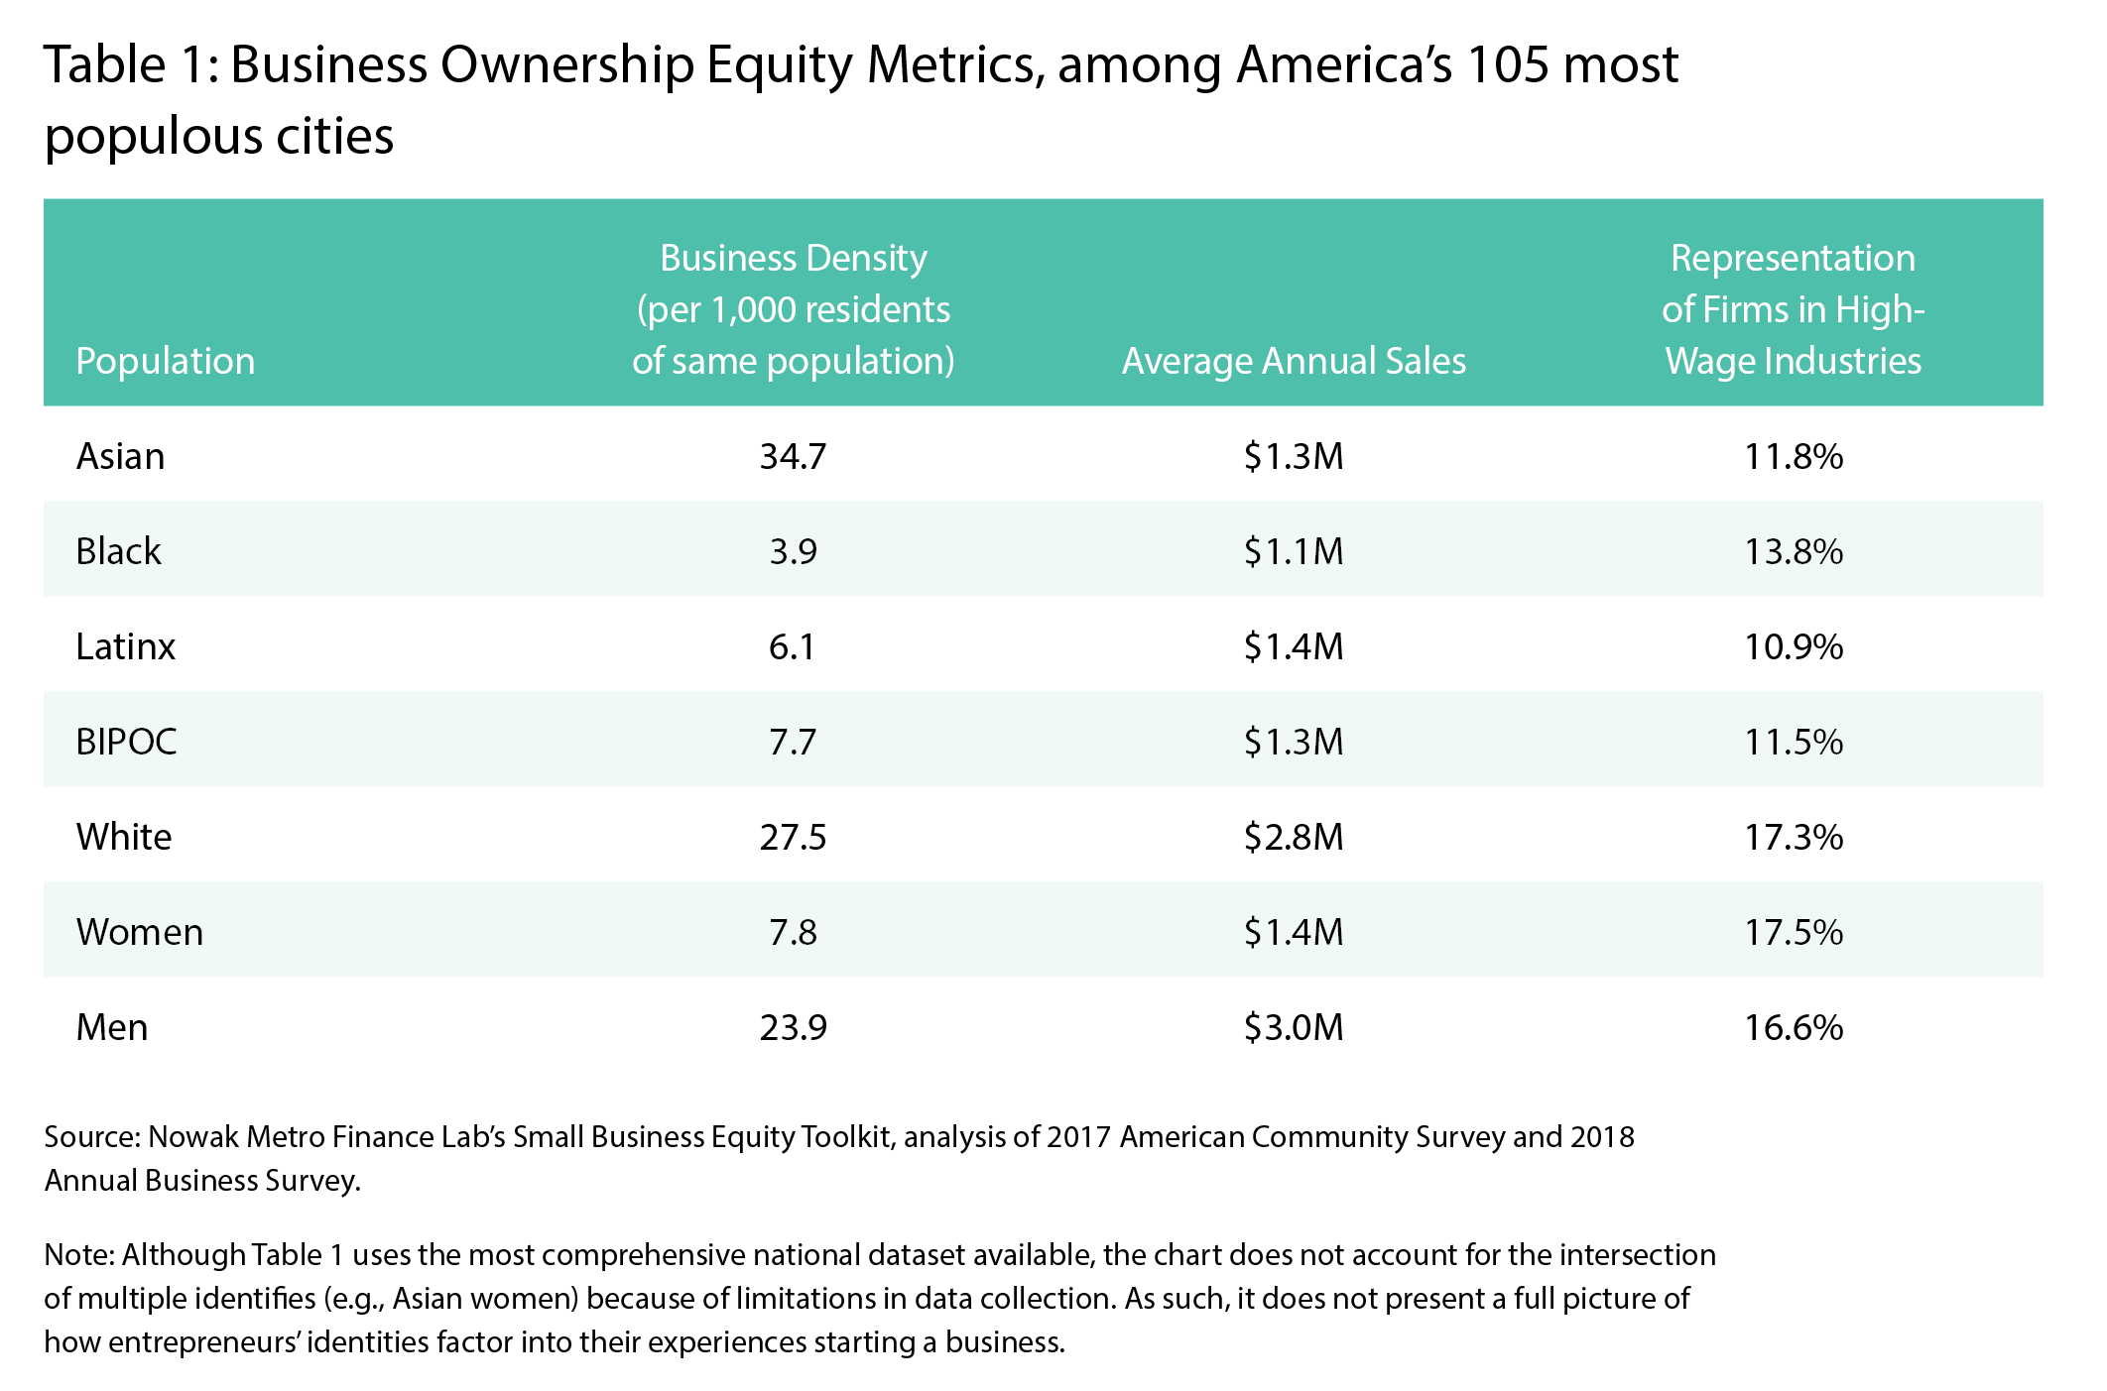



ENTREPRENEURSHIP: A HISTORICAL REFLECTION

Slide 6

RECOMMENDATIONS: A ROADMAP TO INCLUSIVE ENTREPRENEURSHIP
Catalogue and convene a full network of entrepreneurship support organizations.
Develop a plan for inclusive entrepreneurship and track metrics for accountability and transparency.
Begin by understanding the entrepreneurship ecosystem’s baseline.
1
2
3
Build a presence in the community to enhance access and facilitate inclusive placemaking.
Offer capital and business support services for entrepreneurs by leveraging city hall’s convening power.
4
5

Slide 7
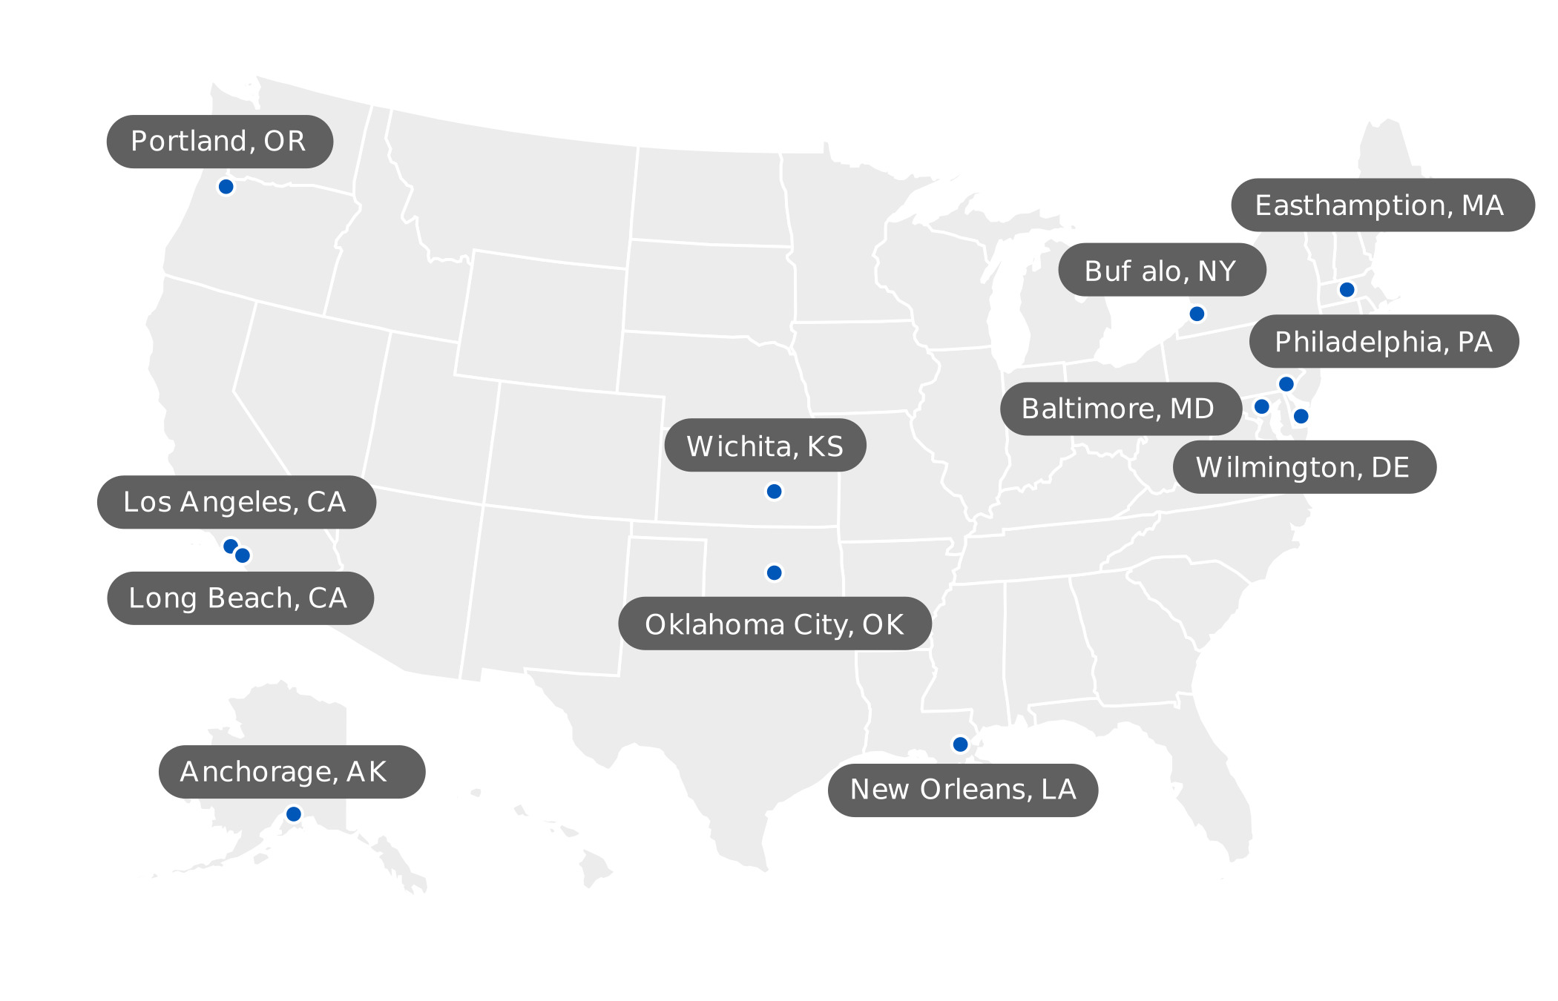
LEARN FROM CITIES
Case Studies
Easthampton, MA
Buffalo, NY
DOWNLOAD REPORT

Slide 8
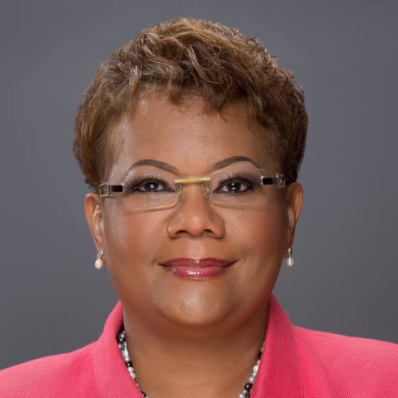
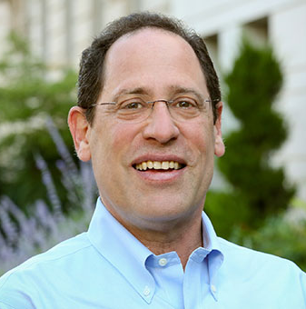
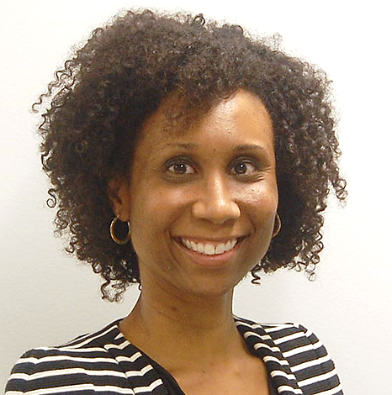
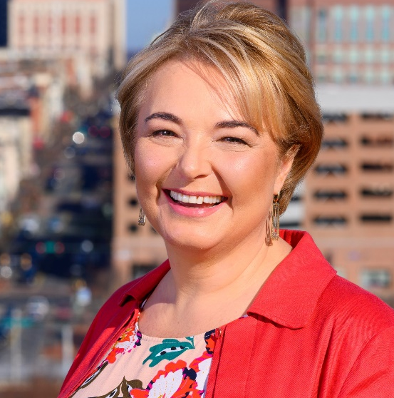
PANELISTS
Della Clark
PRESIDENT AND CEO THE ENTERPRISE CENTER
Bruce Katz
DIRECTOR NOWAK METRO FINANCE LAB
Charisse C. Johnson
MANAGING PARTNER NEXT STREET
Renata B. Kowalczyk
CEO WILMINGTON ALLIANCE

Slide 9
THANK YOU
DOWNLOAD REPORT
GO TO INITIATIVE
For follow-up questions, email media@nlc.org

